Slide 1
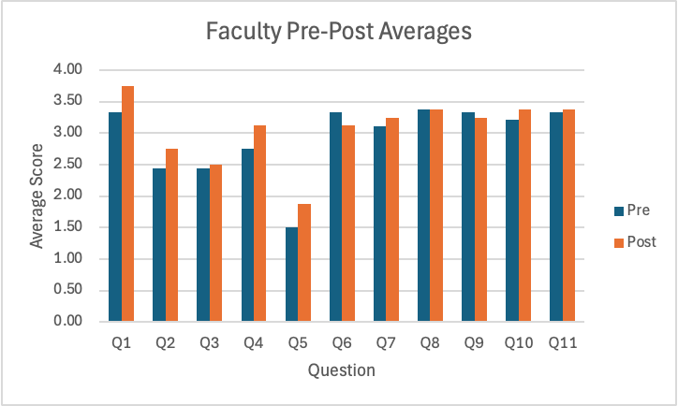
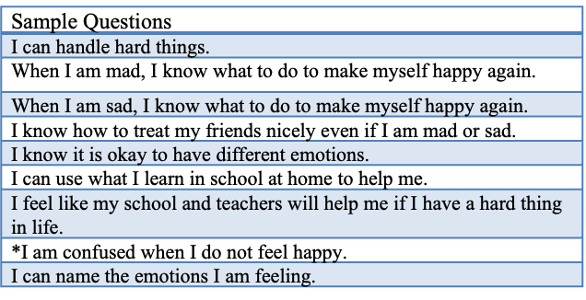
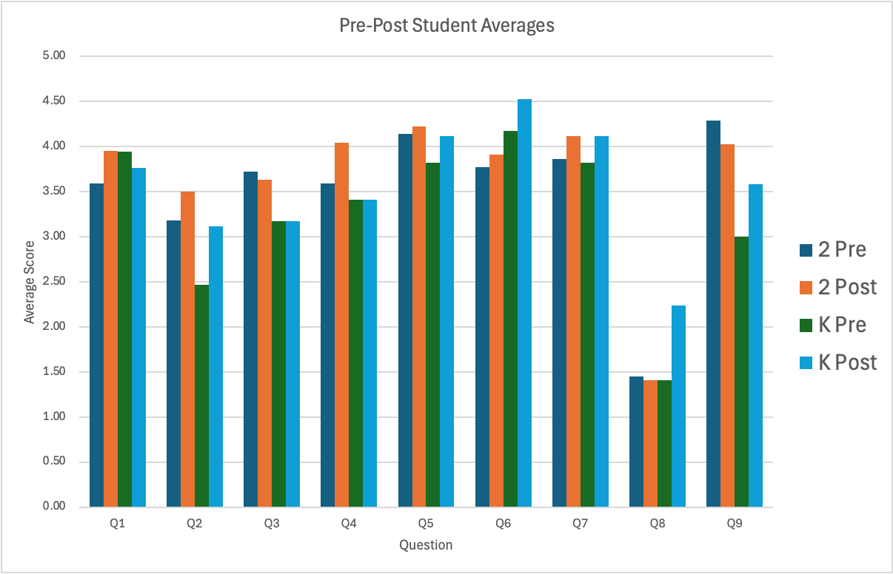

Curving the Crisis: Effects of Emotional Regulation in Schools
Richelle Cameron
Background
Methods
Results
Discussion & Implications
Since the pandemic, mental health needs increased by at least 20% (MHA, 2020).
The cancellation of social activities has led to a 2-3 year delay in behavioral and social skills for students (Corbett, 2022).
There is a limited number of mental health practitioners to fulfill this growing need (AIR, 2017).
There is a lack of awareness of how OTs can address these needs (Pfirman et al., 2023).
OTs have expertise in sensory regulation, behavioral analysis, and provide a holistic view in the provision of services (AOTA, 2020).
6-week Study
Data collection occurred in Fall 2025
No statistically significant results due to limitations.
Overall positive trends seen between pre-post surveys for both staff and students.
Observed use of SEL by teachers in targeted classrooms.
Design
Pre-post survey measuring effects of SEL intervention
6-week intervention period with 2 30-min lessons/week; semi-standardized SEL curriculum with below structure
Limitations | Barriers
Small sample size | IRB approval process
Short intervention | Start of school year
Non-standardize tool | Lack of staff rapport
Intervention
Survey
Student: 9 questions on Likert scale of 0-5
Faculty: 11 questions on Likert scale of 1-4
Survey
Participants
17 Kindergarteners
22 Second graders
9 Faculty members
Occupational therapists can effectively implement SEL programs.
Interdisciplinary teams for mental/behavioral health initiatives should include occupational therapists.
Problem & Purpose
Sample
This study occurred in a high-achieving school district that has an increased risk of maladaptive coping strategies (Orcena et al., 2018; Pfirman, 2024).
The school district has a high student to counselor, and counsellors reported an increase in service utilization.
Intervention
Mindfulness Activity
Video Modeling
Application Game
Conclusion
Occupational therapy practitioners offer a unique perspective when addressing SEL needs. OTPs should have a seat at the table during discussion of developing and implementing SEL programs to ensure a holistic approach (Pfirman et al., 2023).
Purpose: Explore and advocate for how occupational therapists can play a role in the development and implementation of SEL programs on interdisciplinary teams.

